Slide 1
OPTIMAL PAIRING OF FOREST ELEMENTS FOR EFFECTIVE MAN-MADE FORESTS
CSC755M – G01
Aquino, Kurt Neil
Choy, Matthew Seaver
Matias, Angelo

Slide 2
Thesis Statement
With the current methods of repopulating forests being inefficient due to their inability to mimic the diverse and sustainable qualities of natural forests, this project aims to create an application that optimally groups together various kinds of trees and greenery in order to suggest and map out an effective natural forest.

Slide 3
Outline
Introduction
Research Objectives
Proposed Solution
Research Methodology
Results
The Solution
Conclusion

Slide 4
Introduction
With the increasing pace of globalization and the advancement of technology, industrialization and urbanization has caused the decrease of the amount of forest lands in the world. In order to balance this out, many countries have been opting out to repopulate these forests. This process of repopulating is called “reforestation”.
Goltenboth (1999) discusses that the process of reforestation is not just simply the replanting of trees, but instead should be a sustainable farming system used as a strategy for the restoration of a forest with the use of native or indigenous tree species, combined with agricultural crops.
The objective of reforestation is to recreate an ecosystem as close as possible to the original state of a forest.
The Philippines, however, have only been using Narra and foreign exotic species in their efforts for repopulating forests (Milan and Calomot, 1994).

Slide 5
General Research Objective
The general objective of this project is to analyze the problems brought about by the current methodologies of reforestation, propose a possible solution, and develop an application that would get it implemented.

Slide 6
Specific Research Objectives
To determine and analyze the impact of deforestation on students, homeowners, and related experts with regards to their experience and knowledge in agriculture
To assess the current process of reforestation in the Philippines.
To identify the potential problems with the current process of reforestation in the Philippines.
To propose a possible solution(s) to the identified problems based on existing related literature.
To implement the proposed solution through the development of an application that would help solve the current problem

Slide 7
Research Methodology
For the agriculture expert, the group focused on gathering information with regards to the current processes of reforestation and the application of permaculture principles within their methodologies.
For the computer studies expert, the group has discussed the feasibility and the hypothetical effectiveness of the proposed application with regards to addressing the problem statement.
The instrument used for gathering data and information from both the agriculture experts and computer studies experts is a semi-standardized interview
As for the instrument used for the data gathering from the public, a survey with a mix of numerical, close-ended, and open-ended questions has been used as a questionnaire.

Slide 8
Research Methodology
The gathering of the initial knowledge with regards to information about reforestation methodologies and its problems from the agriculture experts in the form of an interview
The definition of the statement of the problem as according the initial discussion with the agriculture experts.
The brainstorming of possible solutions with regards to the defined problem statement with respect to the research group’s background and experience regarding the subject matter
The assessment and evaluation of the proposed solution by the agriculture expert
The gathering of demographic data from the target audience and respondents in the form of a survey
The assessment, analyzation, and documentation of all of the gathered data and responses.
Development of an application that would solve the problem

Slide 9
Results
the group was able to gather a total of 60 respondents for the surveys.
37 (62%) being students.
16 (27%) being homeowners.
7 (11%) listed under others.

Slide 10
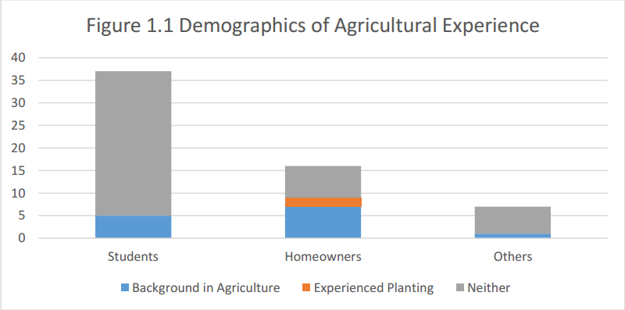
Results
Only 13 (27%) of the respondents had any background in agriculture.
Only 2 of those 13 respondents had experience in planting their own garden (0.03% of the total)
They had no plans on planting their own gardens due to the hassle and effort

Slide 11
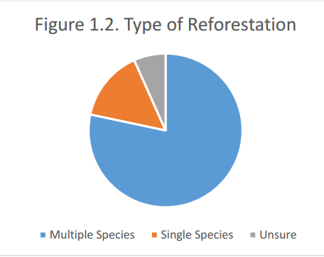
Results
47 (78%) respondents agreed that multiple species should be planted.
9 (15%) who suggested that only a single species of plants should be planted during reforestations.
4 (7%) respondents were unsure.
This further clarifies which respondents have a background in agriculture as the diversification of a forest is key to ensuring a sustainable ecosystem.

Slide 12
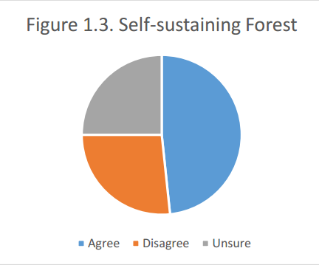
Results
29 (48%) agreed that forests should be self-sustaining.
16 (27%) disagreed.
15 (25%) of the respondents were unsure.
More of the respondents were divided as according to their understating of what a self-sustaining forest is.
Others discussed that these forests should be able to maintain themselves in the long run but should still be monitored from time to time.
While others discussed that the process of reforestation itself contradicts this question as reforestation involves the intervention of humans

Slide 13
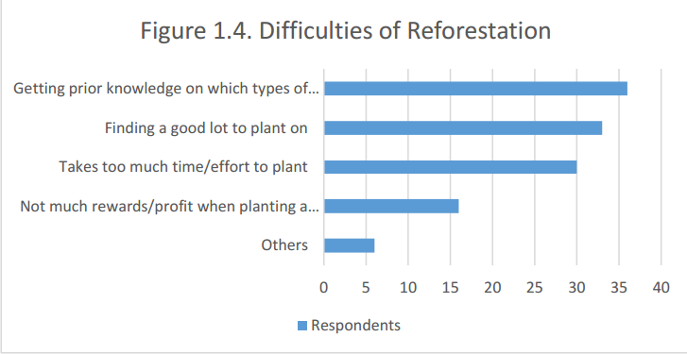
Results
Majority of the respondents have shown that getting prior knowledge on which types to plant during reforestations requires the most effort.

Slide 14
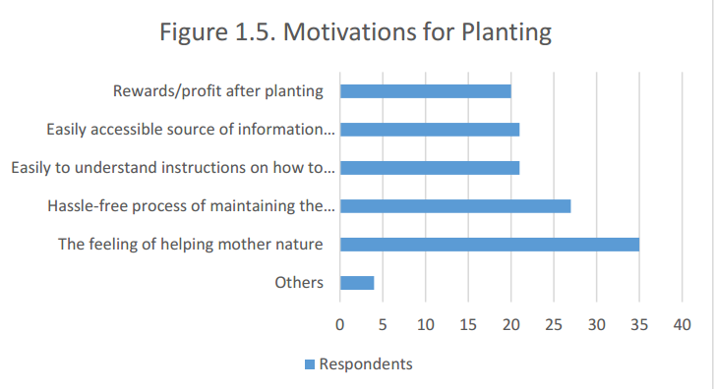
Results
Disregarding the subjective option of “the feeling of helping Mother Nature”, the “Hassle-free maintenance” can be considered as the most effective motivation, further emphasizing the hassle and difficulty of reforestation

Slide 15
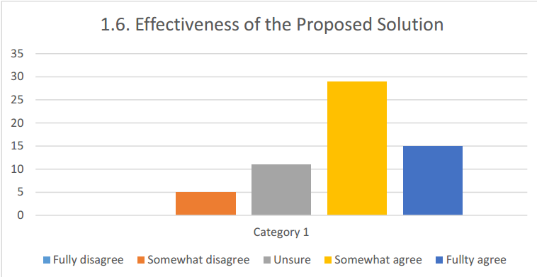
Results
Majority agreed on the proposed solutions effectiveness

Slide 16
Results
The agricultural expert stated different concepts pertaining to how a forest would remain sustainable and it is best designed.
In order to keep a forest sustainable, varying species should be planted so that each plant would be able to use each other for their own advantage.
In an ideal forest, there is a give and take environment.

Slide 17
The Solution
A forest should optimally have the tallest ones in the north and the shortest ones in the south to equally distribute the amount of sunlight to each of the elements inside the forest.
An algorithm based on the solution for the stable marriage problem could be used to pair up different species of trees to their optimal position inside the forest considering their height and shade tolerance.

Slide 18
The Solution
North
Elements are divided into 3 categories based on their height:
Tall (3x3)
Medium (2x2)
Short (1x1)
The tiles in the northern part prefers to be paired with taller and sun demanding elements while tiles in the southern part prefers to be paired with shorter ones

Slide 19
The Solution
North
For each iteration, the algorithm for stable marriage would be used to pair trees to their optimal positions
Gradually filling up the plot of land starting from left to right
In addition, the trees adjacent to them would also be considered so as to avoid planting too many trees of the same species in the forest thereby promoting biodiversity.

Slide 20
The Solution
North
For each iteration, the algorithm for stable marriage would be used to pair trees to their optimal positions
Gradually filling up the plot of land starting from left to right
In addition, the trees adjacent to them would also be considered so as to avoid planting too many trees of the same species in the forest thereby promoting biodiversity.

Slide 21
Conclusion
The overall process of reforestation is considered as a hassle for common people who are not dedicated to the field of reforestation/agriculture and that majority would not even consider planting, even on a small scale (such as on a home garden or small lot) if the hassle of maintaining the garden is present.
The group were able create a solution that would aid in the data gathering/research phase of reforestation thereby allowing its users to focus on other tasks at hand. Which was considered effective and helpful by an agricultural expert.

